Slide 1
Comparing and contrasting Celtic and Roman homes and items from their daily lives

Slide 2
Sort the pictures of Celtic and Roman places and things onto the Venn diagram
Both the Celts and Romans
The Celts
The Romans

Slide 3
Comparing and contrasting
Last week we practised sentences starting with:
The Celts and Romans both..................
They also both...................
The Celts ................................whereas the Romans............................

Slide 4
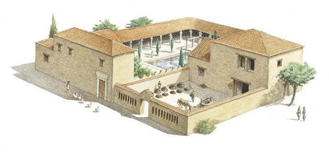
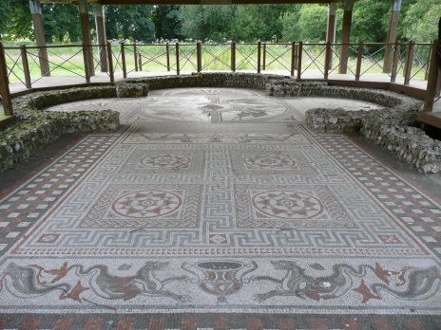
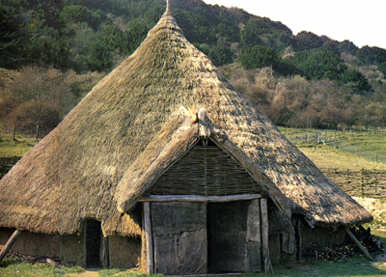
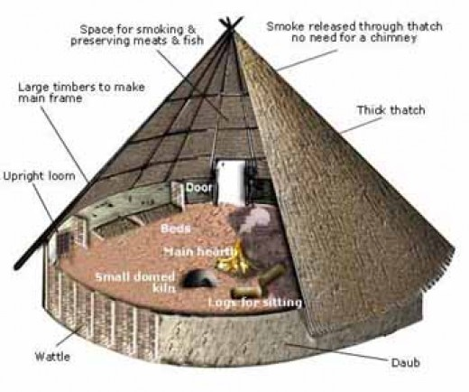
Look at the pictures of Celtic and Roman houses. Can you name and describe the parts shown by the arrows.

Slide 5
courtyard
tiled roof
bedrooms
mosaic floors
windows
thatched roof
stone gates
timber walls
timber doors
ground covered with animal skins

Slide 6
Look at the pictures of the Celtic and Roman houses. Listen to the sentences and decide whether they are true or false
(Sentences not shown to the pupils)
Roman houses were made of brick
Celtic houses were made of brick
The roofs of Roman houses were thatched.
The floors of Celtic houses were tiled.
Roman houses had no windows.
Celtic houses had many rooms.
Roman houses had a courtyard with no roof.
Can you remember one difference?

Slide 7
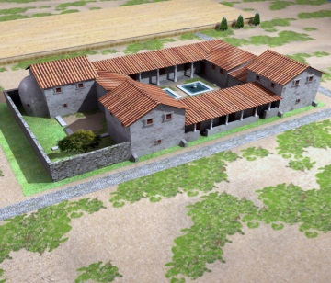
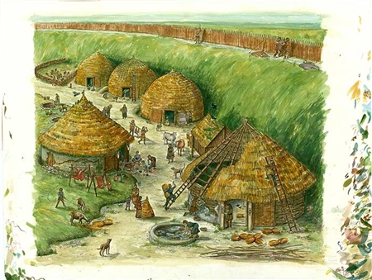
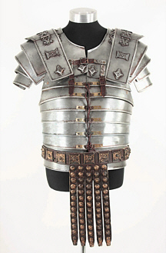
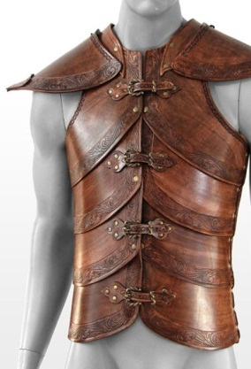
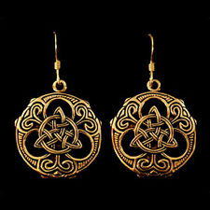
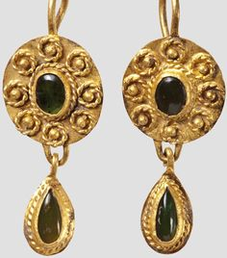
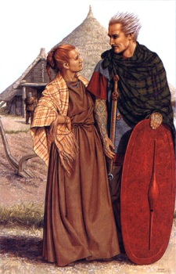
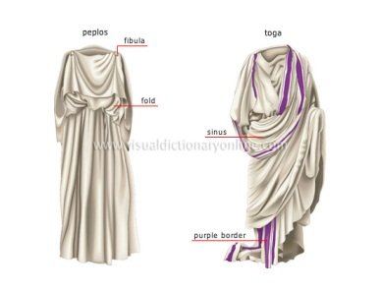
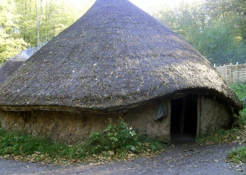
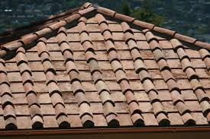
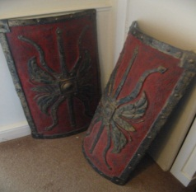
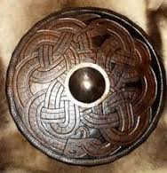
Describing Celtic and Roman things
Can you put a word in front of each name of a place or object
earrings
houses
metal
armour
wooden
patterned
thatched
timber
leather
tiled
clothes
brick
dangling
Make some sentences
The Celts
The Romans
Celtic houses
Roman houses
roofs
shields
had

Slide 8
Listen to the text about Celtic and Roman places and things.
The Celts and the Romans lived very different lives and had many different things.
One difference was that the Celts lived in round timber houses whereas the Romans lived in rectangular brick houses. Celtic houses were covered with brown thatched roofs whereas Roman houses had red tiled roofs.
Another difference was that Celts wore colourful woollen clothes but the Romans mostly had plain woollen clothes. Celtic women wore small patterned earrings whereas Roman women had long dangling earrings.
Celtic warriors were protected by light leather armour and carried round leather shields while Roman soldiers were protected by heavy metal armour and had rectangular wooden shields.

Slide 9
Listening Activity
1. Listen to the text. In pairs match the words that go together to make sentences.
 |  | round | woollen
 |  | rectangular | woollen | houses
 |  | brown | timber
Celtic houses |  | red | thatched | roofs
 |  | colourful | brick
The Celts |  | plain | tiled | clothes
 | had | small | dangling
The Romans |  | long | leather | earrings
 |  | light | metal
Roman houses |  | round | patterned | armour
 |  | heavy | wooden
 |  | rectangular | leather | shields
2. Can you make some sentences using the words below
lived carried wore were covered with were protected by

Slide 10
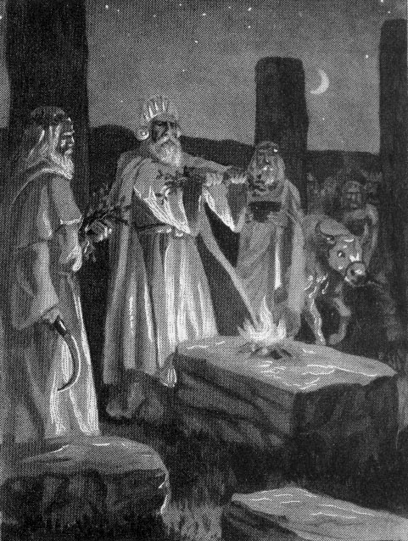
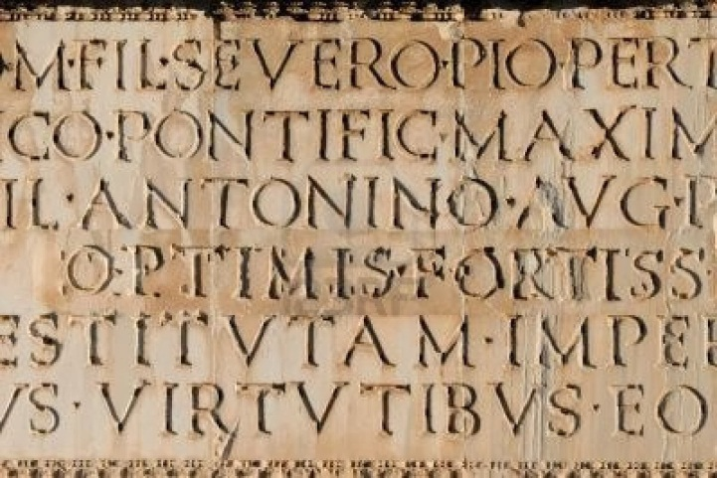
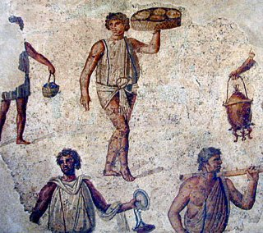
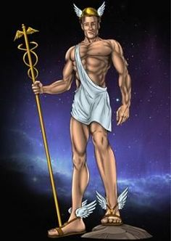
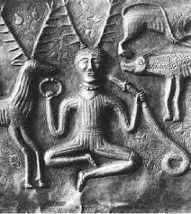
What do you think these are pictures of?
I think this is a picture of ................ because..................................

Slide 11
What the Celts and Romans did and thought
Sort the statements into what Celts thought and what Romans thought
We don’t have any slaves.
We speak Latin and we will try to our enemies Latin.
We prefer to live in the countryside in small villages.
We are ruled by kings and queens.
We believe in spirits that live in trees, mountains and lakes.
We prefer to live in towns.
We need slaves to work in our homes.
We believe in gods that look like people.
We are ruled by the Emperor.
We don’t believe in people being sacrificed.
We believe in sacrificing people.
Most of us don’t understand Latin.

Slide 12
Write one thing in each column. What the Celts and Romans did. What the Celts and Romans had. What the Celts and Romans thought.
Celts
did | had | thought
Romans
did | had | thought

Slide 13
Write some statements about what was similar about the Celts and Romans.
Write some statements about what was different about the Celts and Romans.
The Celts
Both the Celts and Romans
The Romans
Coins had animals
Coins had the Emperor’s head
used coins

Slide 14
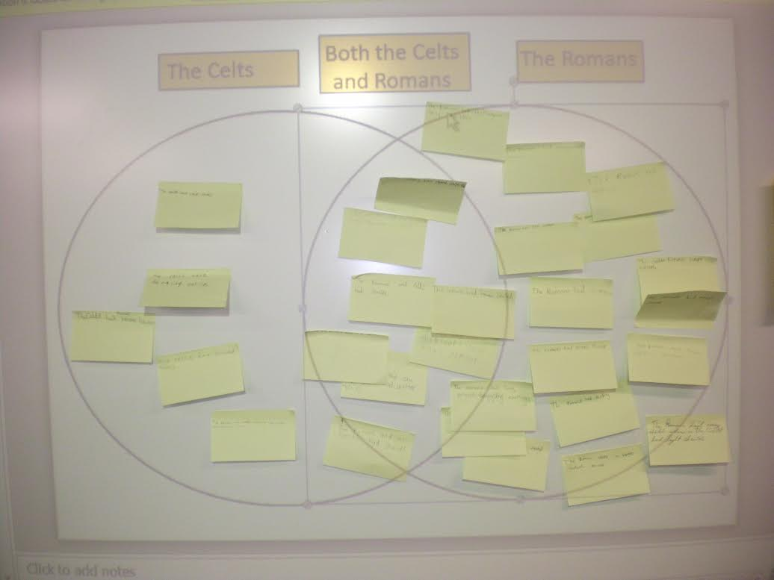

Slide 15
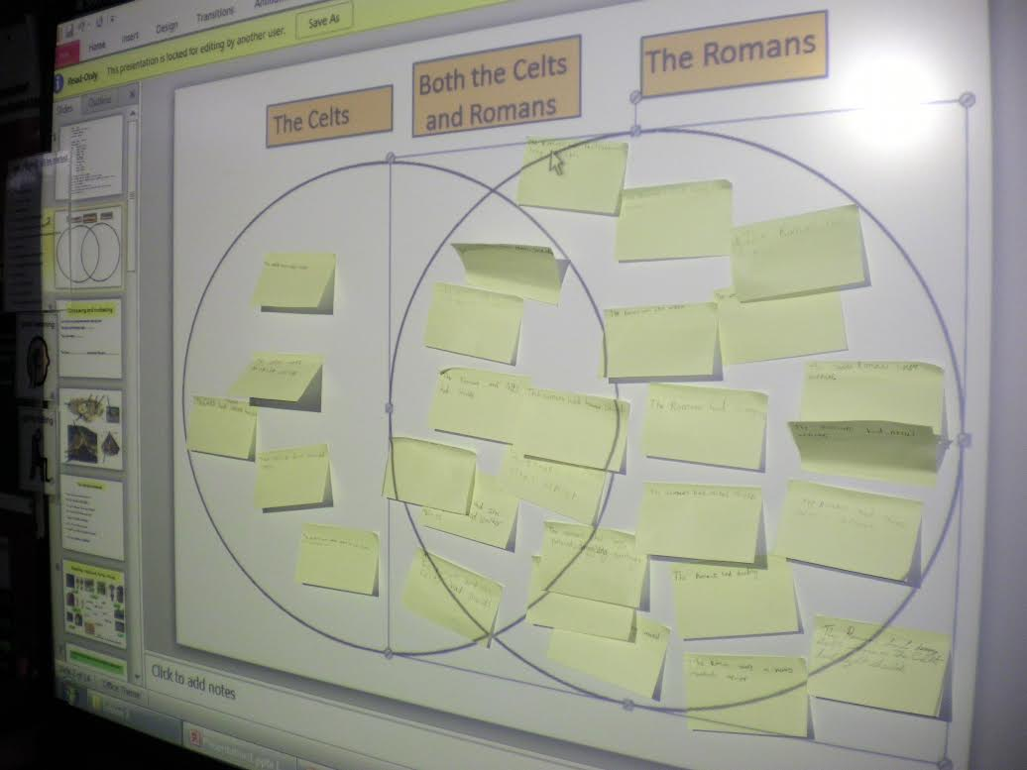

Slide 16
Compare and Contrast the Lives of Celts and Romans
Practise these sentence structures with your own sentences. Then write them
The Romans and Celts were similar in some ways.
For example they both.....................
They also both .....................
Another example is that they both........................
They were also different in many ways.
One difference was that the Celts ............................ whereas the Romans.........................
Another difference was that they..............................but the Romans..........................
The Celts also............................ while.......................................................

Slide 17
Cut the cards out to make sentences
The Romans
lived in
wooden
houses
wore
plain
clothes
The Celts
earrings
colourful
carried
patterned
armour
gold and silver
shields
metal
plain

